Slide 1
Column-Family Stores

Slide 2
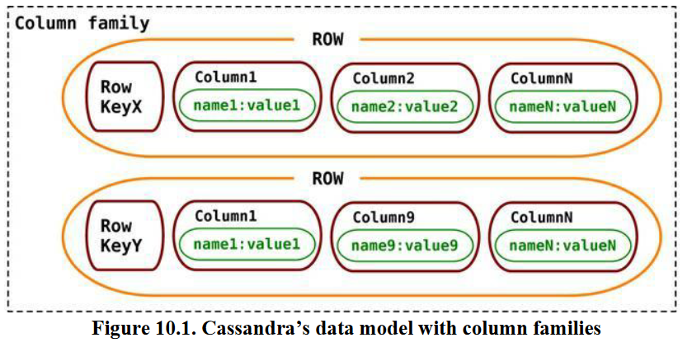
What Is a Column-Family Data Store?
Column-family databases store data in column families as rows that have many columns associated with a row key.
Column families are groups of related data that is often accessed together. For a Customer, we would often access their Profile information at the same time.

Slide 3
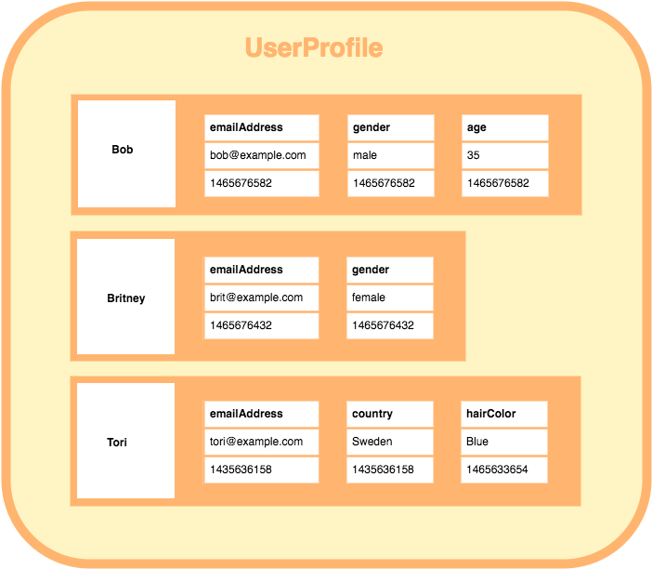

Slide 4
What Is a Column-Family Data Store?
Cassandra is one of the popular column-family databases; there are others, such as HBase, Hypertable, and Amazon DynamoDB
Cassandra can be described as fast and easily scalable.
The cluster does not have a master node, so any read and write can be handled by any node in the cluster.

Slide 5
Features
//super column family {
name: "billing:martin-fowler",
value: {
address: {
name: "address:default",
value: {
fullName: "Martin Fowler",
street:"100 N. Main Street",
zip: "20145“
}
},
billing: {
name: "billing:default",
value: {
creditcard: "8888-8888-8888-8888",
expDate: "12/2016"
}
}
}
When the columns in a column family are simple columns, the column family is known as standard column family.
When a column consists of a map of columns, then we have a super column.
A super column consists of a name and a value which is a map of columns.
Think of a super column as a container of columns.

Slide 6
Features
Consistency
Transactions
Availability
Query features
Scaling

Slide 7
Consistency
by Cassandra, the data is first recorded in a commit log, then written to an in-memory structure known as memtable.
A write operation is considered successful once it’s written to the commit log and the memtable.
Writes are batched in memory and periodically written out to structures known as SSTable.
SSTables are not written to again after they are flushed; if there are changes to the data, a new SSTable is written. Unused SSTables are reclaimed by compactation.
The consistency of ONE is good if you have very high write performance requirements and also do not mind if some writes are lost, which may happen if the node goes down before the write is replicated to other nodes.

Slide 8
Transactions
In Cassandra, a write is atomic at the row level, which means inserting or updating columns for a given row key will be treated as a single write and will either succeed or fail.
Availability
Cassandra is by design highly available, since there is no master in the cluster and every node is a peer in the cluster.
The availability of a cluster can be increased by reducing the consistency level of the requests
Availability is governed by the (R + W) > N formula.
Where W - minimum number of nodes where the write must be successfully written
Where R - minimum number of nodes that must respond successfully to a read
Where N - number of nodes participating in the replication of data

Slide 9
In a 10-node Cassandra cluster with a replication factor for the keyspace set to 3 (N = 3), if we set R = 2 and W = 2, then we have (2 + 2) > 3.
In this scenario, when one node goes down, availability is not affected much, as the data can be retrieved from the other two nodes.
If W = 2 and R = 1, when two nodes are down the cluster is not available for write but we can still read. Similarly, if R = 2 and W = 1, we can write but the cluster is not available for read.
With the R + W > N equation, you are making conscious decisions about consistency tradeoffs.
You should set up your keyspaces and read/write operations based on your needs—higher availability for write or higher availability for read.

Slide 10
Query Features
When designing the data model in Cassandra, it is advised to make the columns and column families optimized for reading the data,
as it does not have a rich query language;
as data is inserted in the column families, data in each row is sorted by column names.
If we have a column that is retrieved much more often than other columns, it’s better performance-wise to use that value for the row key instead.
Basic Queries
Cassandra client include the GET, SET, and DEL.
we have to issue the keyspace command use ecommerce;
This ensures that all of our queries are run against the keyspace that we put our data into.
Before starting to use the column family in the keyspace, we have to define the column family

Slide 11
Basic Queries
CREATE COLUMN FAMILY Customer WITH comparator = UTF8Type AND key_validation_class=UTF8Type AND column_metadata = [ {column_name: city, validation_class: UTF8Type} {column_name: name, validation_class: UTF8Type} {column_name: web, validation_class: UTF8Type} ];
We have a column family named Customer with name, city, and web columns, and we are inserting data in the column family with a Cassandra client
SET Customer['mfowler']['city']='Boston';
SET Customer['mfowler']['name']='Martin Fowler';
SET Customer['mfowler']['web']='www.martinfowler.com';

Slide 12
Advanced Queries and Indexing
Cassandra allows you to index columns other than the keys for the column family.
UPDATE COLUMN FAMILY Customer WITH comparator = UTF8Type AND column_metadata = [{column_name: city, validation_class: UTF8Type, index_type: KEYS}];
We can now query directly against the indexed column.
GET Customer WHERE city = 'Boston’;
These indexes are implemented as bit-mapped indexes and perform well for low-cardinality column values.

Slide 13
Cassandra Query Language (CQL)
Cassandra has a query language that supports SQL-like commands, known as Cassandra Query Language (CQL). We can use the CQL commands to create a column family.
CREATE COLUMNFAMILY Customer ( KEY varchar PRIMARY KEY, name varchar, city varchar, web varchar);
We insert the same data using CQL.
INSERT INTO Customer (KEY,name,city,web) VALUES ('mfowler’, 'Martin Fowler', 'Boston', 'www.martinfowler.com’);
We can read data using the SELECT command. Here we read all the columns:
SELECT * FROM Customer
Or, we could just SELECT the columns we need.
SELECT name,web FROM Customer
Indexing columns are created using the CREATE INDEX command, and then can be used to query the data.

Slide 14
Scaling
Scaling an existing Cassandra cluster is a matter of adding more nodes.
As no single node is a master, when we add nodes to the cluster we are improving the capacity of the cluster to support more writes and reads.
This type of horizontal scaling allows you to have maximum uptime, as the cluster keeps serving requests from the clients while new nodes are being added to the cluster.

Slide 15
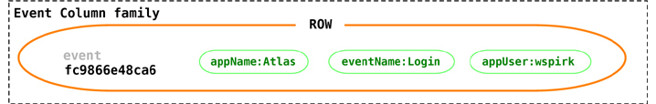
Suitable Use Cases
Event Logging
Content Management Systems, Blogging Platforms
Counters - count and categorize visitors of a page to calculate analytic
Expiring Usage: demo access, Which will be deleted on specific time period.

Slide 16
When Not to Use
Systems that require ACID transactions for writes and reads.

